Slide 1
Sociology 125
Lecture 13
Class
March 2, 2017

Slide 2
Key idea
GRADATIONAL vs RELATIONAL INEQUALITY
Gradational inequality = a ladder or scale of inequality: upper, upper middle, middle, lower middle, lower
Relational inequality = a structure of social relations that bind together the advantaged and disadvantaged: capitalists and workers; lords and serfs.

Slide 3
Key idea
GRADATIONAL vs RELATIONAL INEQUALITY
Gradational inequality = a ladder or scale of inequality: upper, upper middle, middle, lower middle, lower
Relational inequality = a structure of social relations that bind together the advantaged and disadvantaged: capitalists and workers; lords and serfs.

Slide 4
Key idea
GRADATIONAL vs RELATIONAL INEQUALITY
Gradational inequality = a ladder or scale of inequality: upper, upper middle, middle, lower middle, lower
Relational inequality = a structure of social relations that bind together the advantaged and disadvantaged: capitalists and workers; lords and serfs.

Slide 5
Two Stories
Notes:
GRASSHOPPER & THE ANTS
GRADING CURVE

Slide 6
THREE APPROACHES TO CLASS
1. Individual attributes and material conditions of life
2. Opportunity-hoarding
3. Exploitation and domination

Slide 7
Individual attributes & conditions
Class = clusters of individual attributes connected to unequal material conditions

Slide 8
Opportunity-hoarding
Class = economically unequal social positions protected by processes of social exclusion (credentials, property rights)

Slide 9
Exploitation and domination
Class = economically unequal social positions bound together through relations of exploitation and domination

Slide 10
The Concept of “Exploitation”:
The Saga of
Li’ll Abner & the Shmoo

Slide 20
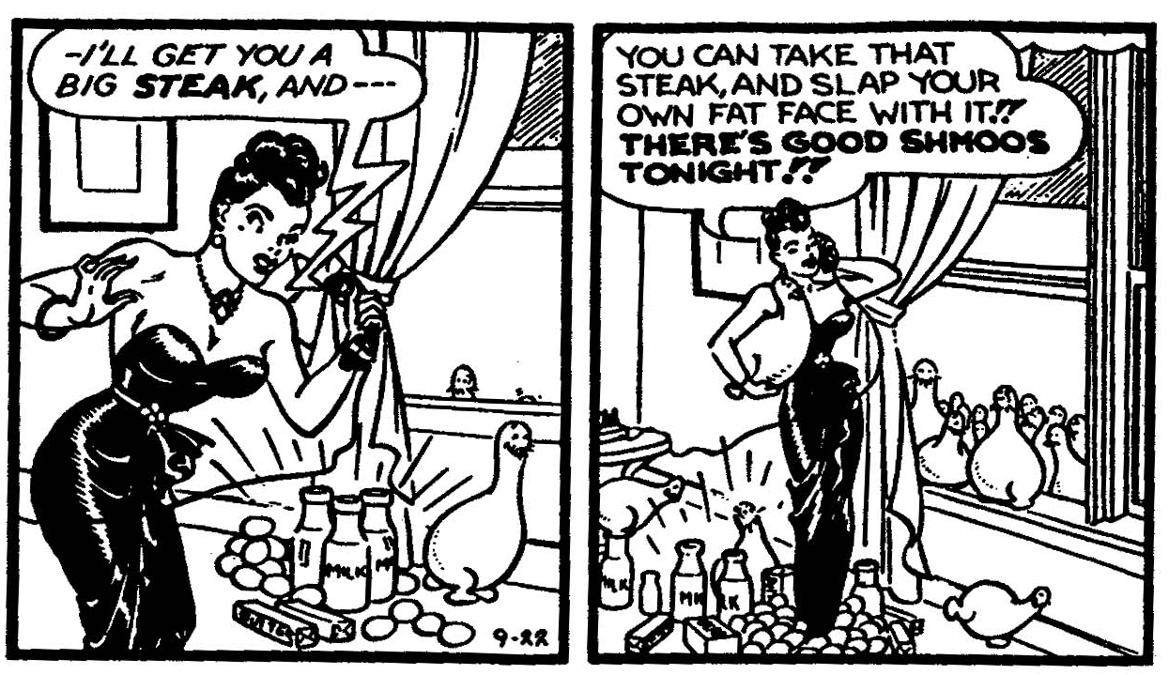

Slide 21
Rank ordering of Preferences of Different Classes for the Fate of the Shmoos
Capitalist Class (the rich) | Working Class (the poor)
1. Only capitalists get shmoos | 1. Everyone gets a shmoo
2. Destroy the shmoos | 2. Only workers get shmoos
3. Everyone gets a shmoo | 3. Only capitalists get shmoos
4. Only workers get shmoos | 4. Destroy the shmoos

Slide 22
Rank ordering of Preferences of Different Classes for the Fate of the Shmoos
Capitalist Class (the rich) | Working Class (the poor)
1. Only capitalists get shmoos | 1. Everyone gets a shmoo
2. Destroy the shmoos | 2. Only workers get shmoos
3. Everyone gets a shmoo | 3. Only capitalists get shmoos
4. Only workers get shmoos | 4. Destroy the shmoos

Slide 23
Rank ordering of Preferences of Different Classes for the Fate of the Shmoos
Capitalist Class (the rich) | Working Class (the poor)
1. Only capitalists get shmoos | 1. Everyone gets a shmoo
2. Destroy the shmoos | 2. Only workers get shmoos
3. Everyone gets a shmoo | 3. Only capitalists get shmoos
4. Only workers get shmoos | 4. Destroy the shmoos

Slide 24
Rank ordering of Preferences of Different Classes for the Fate of the Shmoos
Capitalist Class (the rich) | Working Class (the poor)
1. Only capitalists get shmoos | 1. Everyone gets a shmoo
2. Destroy the shmoos | 2. Only workers get shmoos
3. Everyone gets a shmoo | 3. Only capitalists get shmoos
4. Only workers get shmoos | 4. Destroy the shmoos

Slide 25
Rank ordering of Preferences of Different Classes for the Fate of the Shmoos
Capitalist Class (the rich) | Working Class (the poor)
1. Only capitalists get shmoos | 1. Everyone gets a shmoo
2. Destroy the shmoos | 2. Only workers get shmoos
3. Everyone gets a shmoo | 3. Only capitalists get shmoos
4. Only workers get shmoos | 4. Destroy the shmoos

Slide 26
Rank ordering of Preferences of Different Classes for the Fate of the Shmoos
Capitalist Class (the rich) | Working Class (the poor)
1. Only capitalists get shmoos | 1. Everyone gets a shmoo
2. Destroy the shmoos | 2. Only workers get shmoos
3. Everyone gets a shmoo | 3. Only capitalists get shmoos
4. Only workers get shmoos | 4. Destroy the shmoos

Slide 27
Rank ordering of Preferences of Different Classes for the Fate of the Shmoos
Capitalist Class (the rich) | Working Class (the poor)
1. Only capitalists get shmoos | 1. Everyone gets a shmoo
2. Destroy the shmoos | 2. Only workers get shmoos
3. Everyone gets a shmoo | 3. Only capitalists get shmoos
4. Only workers get shmoos | 4. Destroy the shmoos

Slide 28
Rank ordering of Preferences of Different Classes for the Fate of the Shmoos
Capitalist Class (the rich) | Working Class (the poor)
1. Only capitalists get shmoos | 1. Everyone gets a shmoo
2. Destroy the shmoos | 2. Only workers get shmoos
3. Everyone gets a shmoo | 3. Only capitalists get shmoos
4. Only workers get shmoos | 4. Destroy the shmoos

Slide 29
Rank ordering of Preferences of Different Classes for the Fate of the Shmoos
Capitalist Class (the rich) | Working Class (the poor)
1. Only capitalists get shmoos | 1. Everyone gets a shmoo
2. Destroy the shmoos | 2. Only workers get shmoos
3. Everyone gets a shmoo | 3. Only capitalists get shmoos
4. Only workers get shmoos | 4. Destroy the shmoos

Slide 30
Three Criteria for Defining “Exploitation”
Inverse Interdependent Well-being Principle
The material well-being of the advantaged group of people causally depends upon the material deprivations of the disadvantaged.
(b) The Exclusion Principle
The causal relation in (a) involves the exclusion of the disadvantaged group from access to certain important productive resources controlled by the advantaged group.
(c) The Labor Effort Control Principle (also called “appropriation principle”)
The causal mechanism which translates condition (b) into condition (a) involves the control over the labor effort and the profits from that effort of the disadvantaged group by those who control these productive resources.
Non-exploitative Oppression = (a) + (b)
Exploitation = (a) + (b) + (c)

Slide 31
Putting the three class processes together
The exploitation/domination approach identifies the fundamental class division in a capitalist economy: capitalists and workers.
The opportunity hoarding approach identifies the central processes that differentiates middle class jobs from the broader working class.
The individual attributes approach identifies the key processes through which people get sorted into these positions

Slide 32
Putting the three class processes together
The exploitation/domination approach identifies the fundamental class division in a capitalist economy: capitalists and workers.
The opportunity hoarding approach identifies the central processes that differentiates middle class jobs from the broader working class.
The individual attributes approach identifies the key processes through which people get sorted into these positions

Slide 33
Putting the three class processes together
The exploitation/domination approach identifies the fundamental class division in a capitalist economy: capitalists and workers.
The opportunity hoarding approach identifies the central processes that differentiates middle class jobs from the broader working class.
The individual attributes approach identifies the key processes through which people get sorted into these positions

Slide 34
Putting the three class processes together
The exploitation/domination approach identifies the fundamental class division in a capitalist economy: capitalists and workers.
The opportunity hoarding approach identifies the central processes that differentiates middle class jobs from the broader working class.
The individual attributes approach identifies the key processes through which people get sorted into these positions

Slide 35
THE CLASS STRUCTURE IN THE UNITED STATES TODAY
Capitalist class: An extremely rich and powerful capitalist class and corporate managerial class. The American class structure is highly polarized at the top.
Middle Class: historically vibrant; currently more precarious
Working class: previously protected by unions with a standard of living overlapping middle class; now without protections
The “working poor”: A growing precarious segment of the working class.
The “under class”: A marginalized extremely impoverished part of the population, largely excluded from employment. The American class structure is highly polarized at the bottom.

Slide 36
THE CLASS STRUCTURE IN THE UNITED STATES TODAY
Capitalist class: An extremely rich and powerful capitalist class and corporate managerial class. The American class structure is highly polarized at the top.
Middle Class: historically vibrant; currently more precarious
Working class: previously protected by unions with a standard of living overlapping middle class; now without protections
The “working poor”: A growing precarious segment of the working class.
The “under class”: A marginalized extremely impoverished part of the population, largely excluded from employment. The American class structure is highly polarized at the bottom.

Slide 37
THE CLASS STRUCTURE IN THE UNITED STATES TODAY
Capitalist class: An extremely rich and powerful capitalist class and corporate managerial class. The American class structure is highly polarized at the top.
Middle Class: historically vibrant; currently more precarious
Working class: previously protected by unions with a standard of living overlapping middle class; now without protections
The “working poor”: A growing precarious segment of the working class.
The “under class”: A marginalized extremely impoverished part of the population, largely excluded from employment. The American class structure is highly polarized at the bottom.

Slide 38
THE CLASS STRUCTURE IN THE UNITED STATES TODAY
Capitalist class: An extremely rich and powerful capitalist class and corporate managerial class. The American class structure is highly polarized at the top.
Middle Class: historically vibrant; currently more precarious
Working class: previously protected by unions with a standard of living overlapping middle class; now without protections
The “working poor”: A growing precarious segment of the working class.
The “under class”: A marginalized extremely impoverished part of the population, largely excluded from employment. The American class structure is highly polarized at the bottom.

Slide 39
THE CLASS STRUCTURE IN THE UNITED STATES TODAY
Capitalist class: An extremely rich and powerful capitalist class and corporate managerial class. The American class structure is highly polarized at the top.
Middle Class: historically vibrant; currently more precarious
Working class: previously protected by unions with a standard of living overlapping middle class; now without protections
The “working poor”: A growing precarious segment of the working class.
The “under class”: A marginalized extremely impoverished part of the population, largely excluded from employment. The American class structure is highly polarized at the bottom.

Slide 40
THE CLASS STRUCTURE IN THE UNITED STATES TODAY
Capitalist class: An extremely rich and powerful capitalist class and corporate managerial class. The American class structure is highly polarized at the top.
Middle Class: historically vibrant; currently more precarious
Working class: previously protected by unions with a standard of living overlapping middle class; now without protections
The “working poor”: A growing precarious segment of the working class.
The “under class”: A marginalized, impoverished, oppressed part of the population, largely excluded from employment. The American class structure is highly polarized at the bottom.

